Slide 1
ngClass

Slide 2
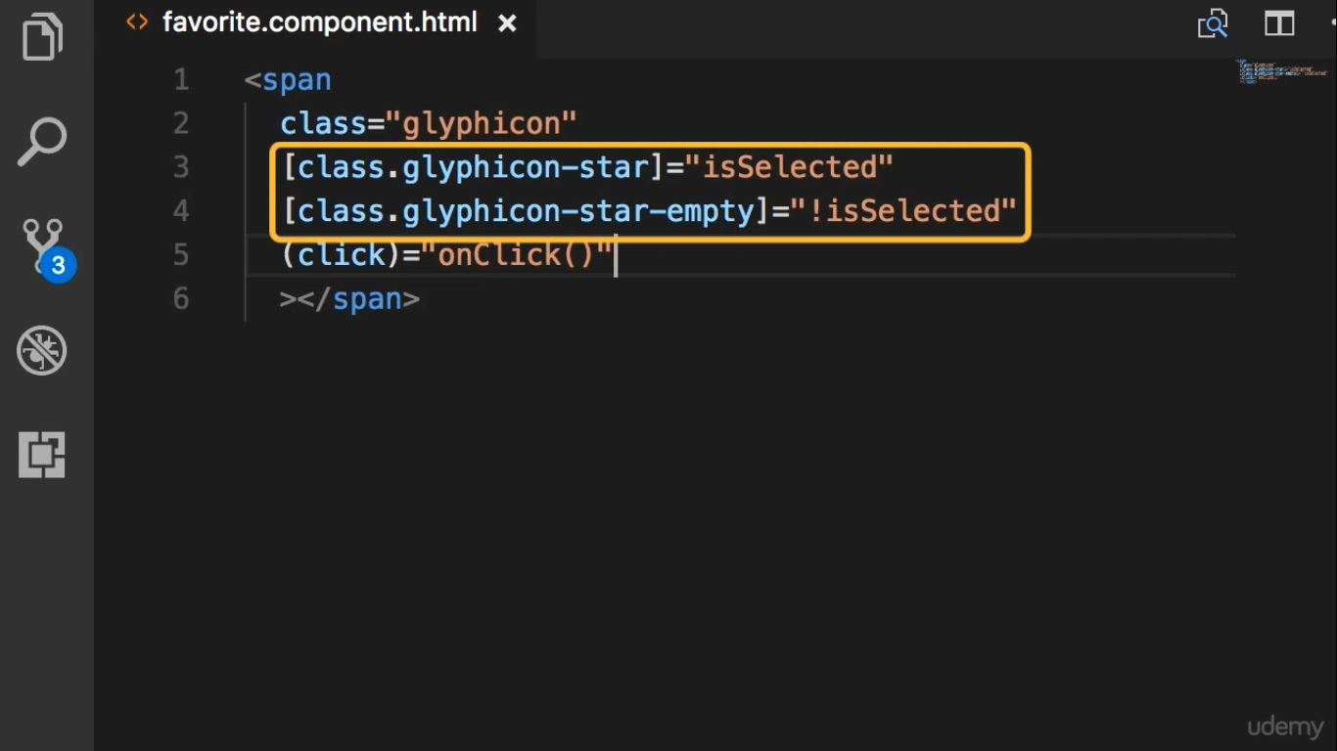

Slide 3
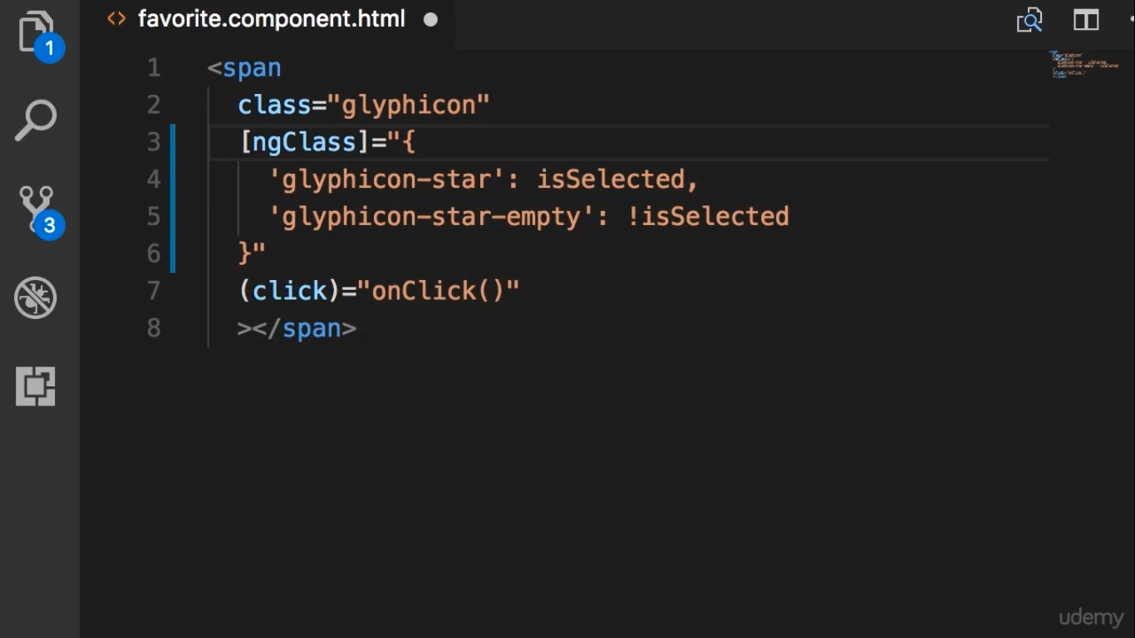
Note that here adds the quote

